Slide 1
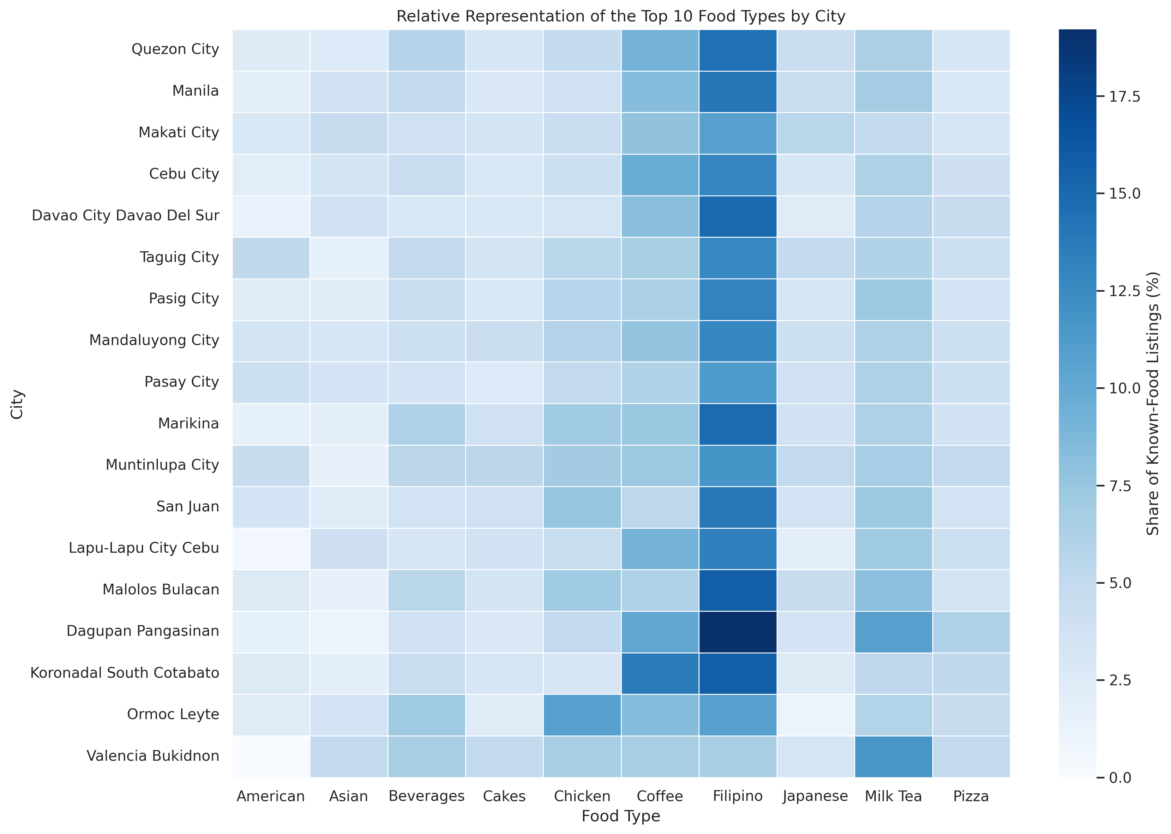
MILESTONE 2 · GROUP 3
Mapping the Philippine Restaurant Landscape
Food-Type Diversity, Customer Engagement, and the Distribution of Restaurant Listings Across Selected Cities
Erika · Arvin · Nathan · Chaim
Notes:
PRESENTER: Erika
SCRIPT
Good day, everyone. We are Group 3: Erika, Arvin, Nathan, and Chaim. Our study maps how Foodpanda restaurant listings differ across selected Philippine cities. We focus on three connected areas: food-type diversity, customer engagement, and the distribution of restaurant listings. Since this is a platform dataset, our findings describe the listings captured in the data, not every restaurant operating in the Philippines.
[Sources]
- Project title and objectives supplied by Group 3
- Foodpanda 2025 Cleaned Data.csv
- 06_food_type_heatmap.png

Slide 2
Our study asks three connected questions
General objective
To analyze the Philippine restaurant landscape across selected cities by examining food-type diversity, customer engagement, and the distribution of restaurant listings using a dataset of Foodpanda restaurant listings collected in 2025.
01
Where are listings concentrated?
02
Which food types are represented?
03
How do reviewer activity and ratings relate?
Presenter: Erika
Milestone 2 | Group 3
2
Notes:
PRESENTER: Erika
SCRIPT
Our general objective is to examine the restaurant landscape represented in the 2025 Foodpanda listing dataset. We turned that broad objective into three simple questions. First, where are restaurant listings concentrated? Second, which food types are represented in each city? Third, how are reviewer activity and ratings connected to these patterns? The next parts of the presentation answer these questions using cleaned data, simple comparisons, and clear charts.
[Sources]
- Group 3 finalized general and specific objectives
- Data Analysis - Milestone 2 - Corrected.ipynb

Slide 3
Cleaning kept the analysis accurate and transparent
12,409
What we addressed
listing records retained
• Trimmed text and standardized lowercase city labels
• Labeled 91 missing food types as “Unknown”
• Separated 3,037 unrated listings from rating analysis
• Flagged repeated IDs and high reviewer counts, but retained them because they were not confirmed errors
18
selected cities
6 → 8
original to analysis-ready columns
Presenter: Erika
Milestone 2 | Group 3
3
Notes:
PRESENTER: Erika
SCRIPT
The raw dataset contained 12,409 listing records from 18 selected cities. We removed extra spaces, standardized the lowercase city labels, and marked 91 missing food types as Unknown. We also separated 3,037 unrated listings so zero would not be treated as a real customer rating. Repeated store IDs and unusually high reviewer counts were investigated and retained because they were not confirmed errors. No records were deleted. I will now turn the presentation over to Arvin, who will explain how we measured the main areas of the study.
[Sources]
- Data Cleanup - Milestone 2.ipynb
- Foodpanda 2025 Raw Data.csv
- Foodpanda 2025 Cleaned Data.csv

Slide 4
Clear definitions keep our claims within the data
What one row means
How we measured the study areas
One restaurant-listing record
It is not automatically one verified, unique operating restaurant.
FOOD-TYPE DIVERSITY
Number of unique known food categories
CUSTOMER ENGAGEMENT
Reviewer counts and ratings among rated listings
LISTING DISTRIBUTION
Counts and percentage shares by city and food type
Presenter: Arvin
Milestone 2 | Group 3
4
Notes:
PRESENTER: Arvin
SCRIPT
Before looking at the charts, we defined each measure carefully. One row represents one Foodpanda listing record. We do not automatically call it one unique operating restaurant because some store IDs repeat. Food-type diversity means the number of unique known food categories listed in a city. Customer engagement uses reviewer counts and ratings from listings with actual reviews. Listing distribution uses counts and percentage shares. These definitions help us avoid claims that the dataset cannot support.
[Sources]
- Data Cleanup - Milestone 2.ipynb
- Data Analysis - Milestone 2 - Corrected.ipynb

Slide 5
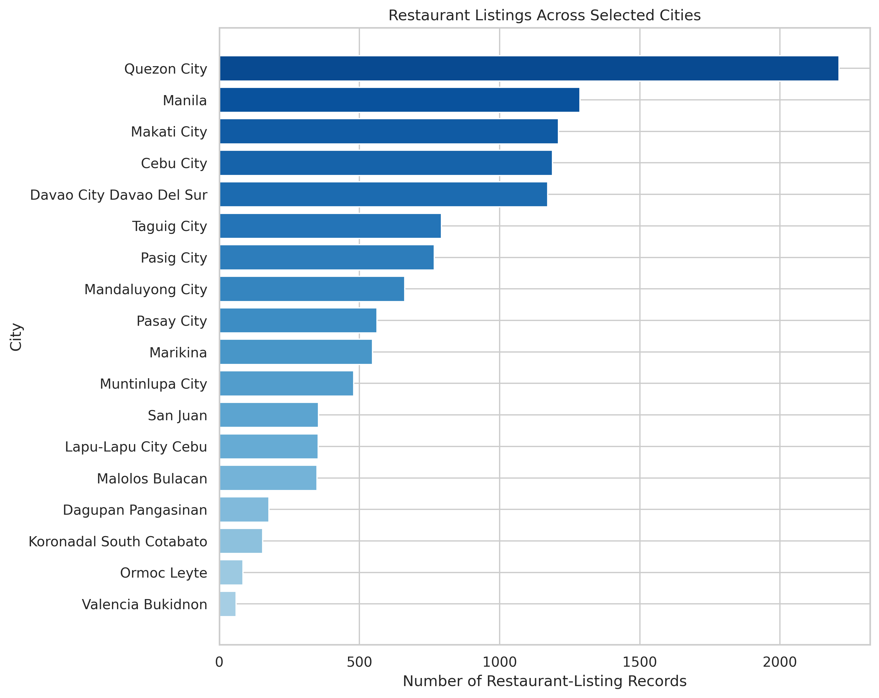
Captured listings are unevenly distributed across cities
Key takeaway
Quezon City has 2,211 captured listings.
Valencia, Bukidnon has 60.
This shows dataset coverage—not each city’s total restaurant population.
Presenter: Arvin
Milestone 2 | Group 3
5
Notes:
PRESENTER: Arvin
SCRIPT
This chart shows how the listing records are distributed across the 18 selected cities. Quezon City has the largest number, with 2,211 captured listings. Valencia, Bukidnon has the fewest, with 60. The main point is that the dataset coverage is uneven. We should not conclude that Quezon City has the most restaurants in real life or that Valencia has the fewest. We can only compare the Foodpanda listings captured in this dataset.
[Sources]
- Foodpanda 2025 Cleaned Data.csv
- 01_city_listing_distribution.png

Slide 6
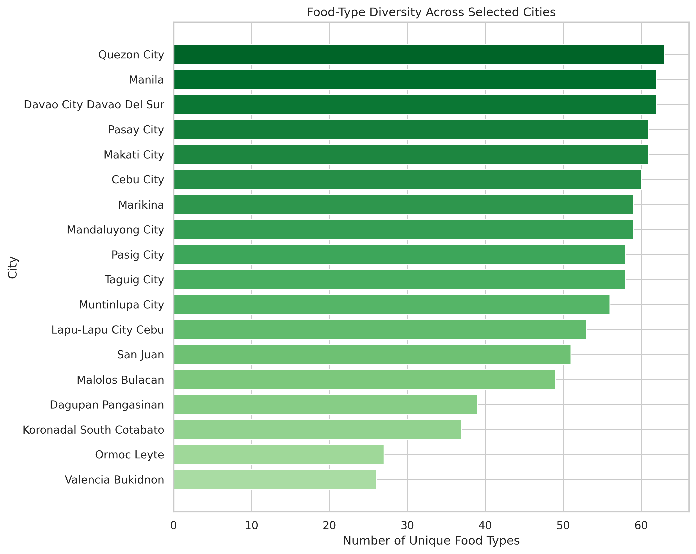
Food-type variety also differs across the selected cities
What it means
Quezon City shows 63 food types.
Davao City and Manila each show 62.
Valencia shows 26.
More captured listings create more chances to record different food types.
Presenter: Arvin
Milestone 2 | Group 3
6
Notes:
PRESENTER: Arvin
SCRIPT
We measured diversity by counting the unique known food-type categories in every city. Quezon City shows 63 categories, while Davao City and Manila each show 62. Valencia, Bukidnon shows 26. However, diversity should be interpreted together with listing coverage. A city with more captured listings has more opportunities to include different categories. I will now pass the discussion to Nathan, who will focus on the food types and customer engagement results.
[Sources]
- Foodpanda 2025 Cleaned Data.csv
- 02_food_type_diversity.png

Slide 7
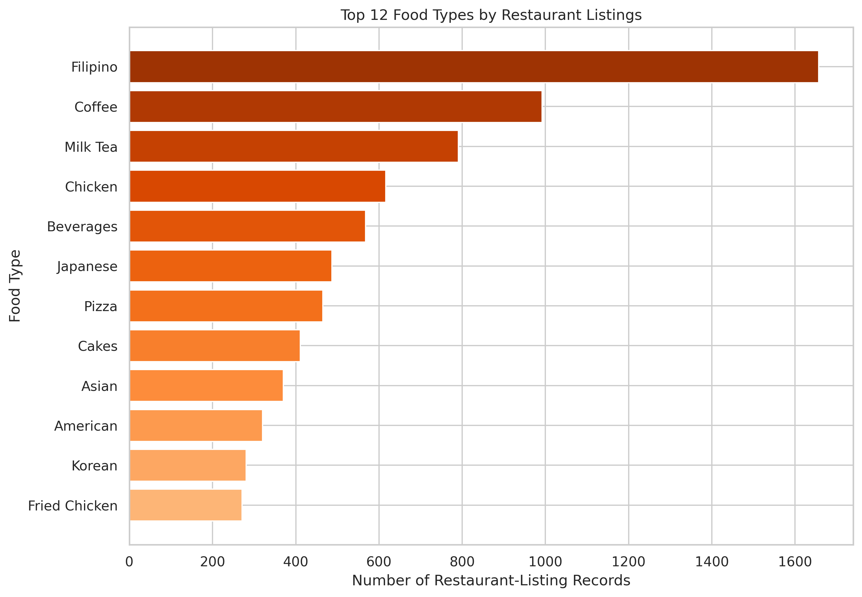
Filipino food is the most represented category
Leading categories
1,657 Filipino listings
992 Coffee listings
791 Milk Tea listings
These counts describe platform representation, not customer preference or actual consumption.
Presenter: Nathan
Milestone 2 | Group 3
7
Notes:
PRESENTER: Nathan
SCRIPT
Across all selected cities, Filipino food is the most represented category, with 1,657 listings. Coffee follows with 992, and Milk Tea with 791. These results describe how often the categories appear in the dataset. They do not prove that Filipino food is everyone’s favorite or that people consume it most often. The chart measures listing presence, not actual purchasing or eating behavior.
[Sources]
- Foodpanda 2025 Cleaned Data.csv
- 03_top_food_types.png

Slide 8
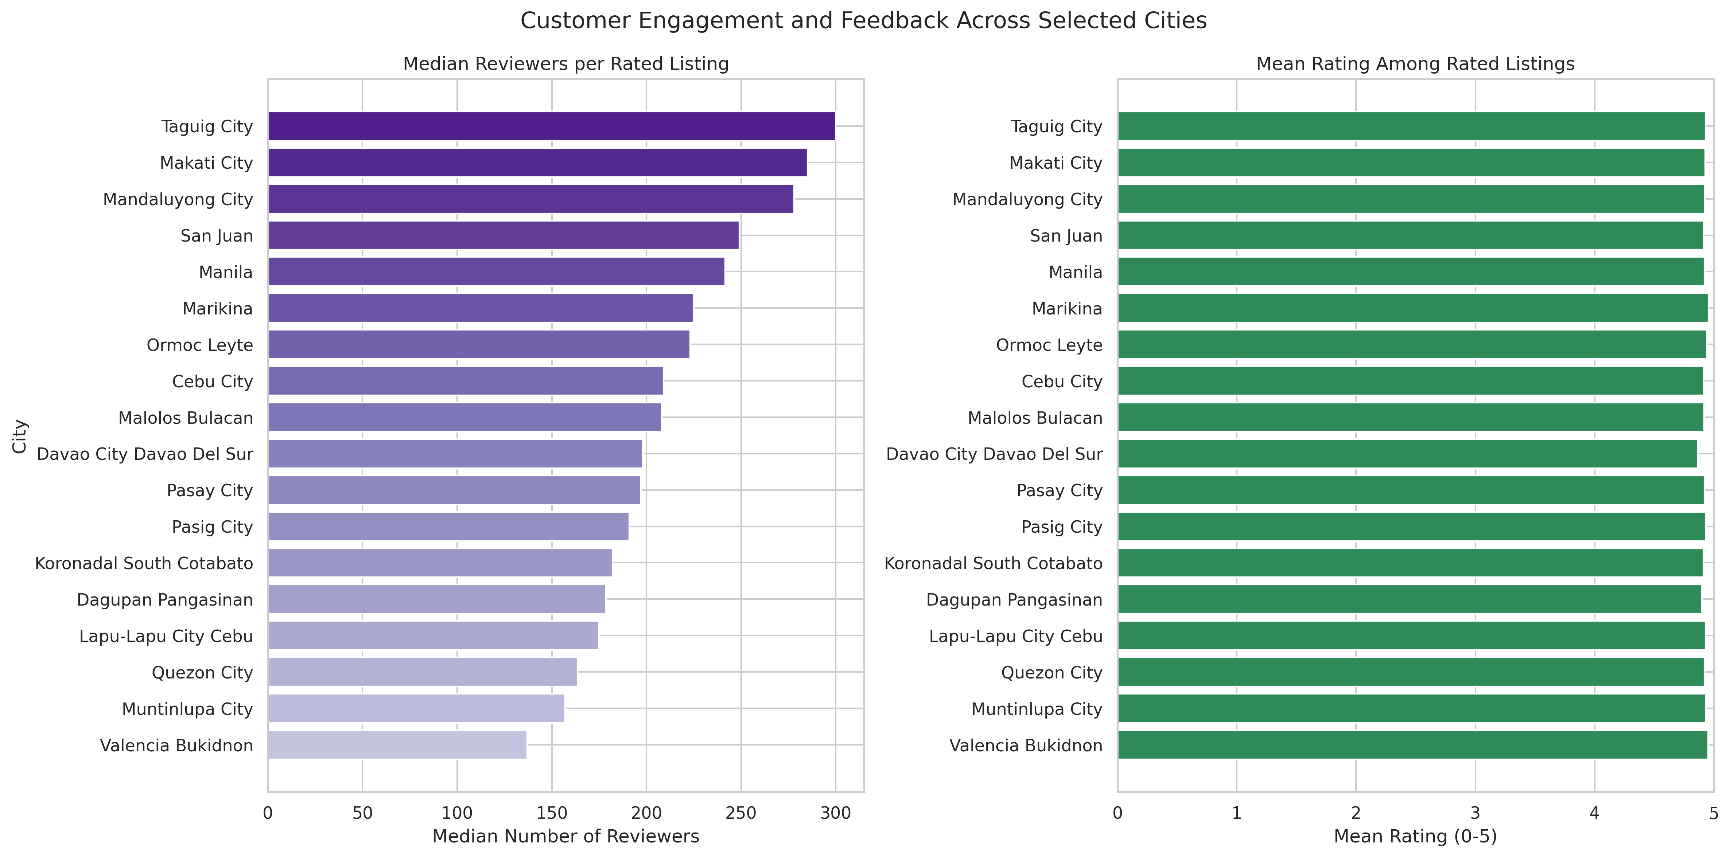
Reviewer activity varies more than average ratings
Ratings stay close to five, while the typical number of reviewers differs noticeably by city.
Presenter: Nathan
Milestone 2 | Group 3
8
Notes:
PRESENTER: Nathan
SCRIPT
The left chart compares the typical reviewer count using the median. We used the median because reviewer counts are highly uneven and include very large values. The right chart uses the full zero-to-five rating scale. Reviewer activity differs noticeably across cities, but the average ratings among rated listings remain tightly grouped, roughly between 4.87 and 4.96. This means reviewer volume separates the cities more clearly than their average ratings do.
[Sources]
- Foodpanda 2025 Cleaned Data.csv
- 04_city_engagement_and_ratings.png

Slide 9
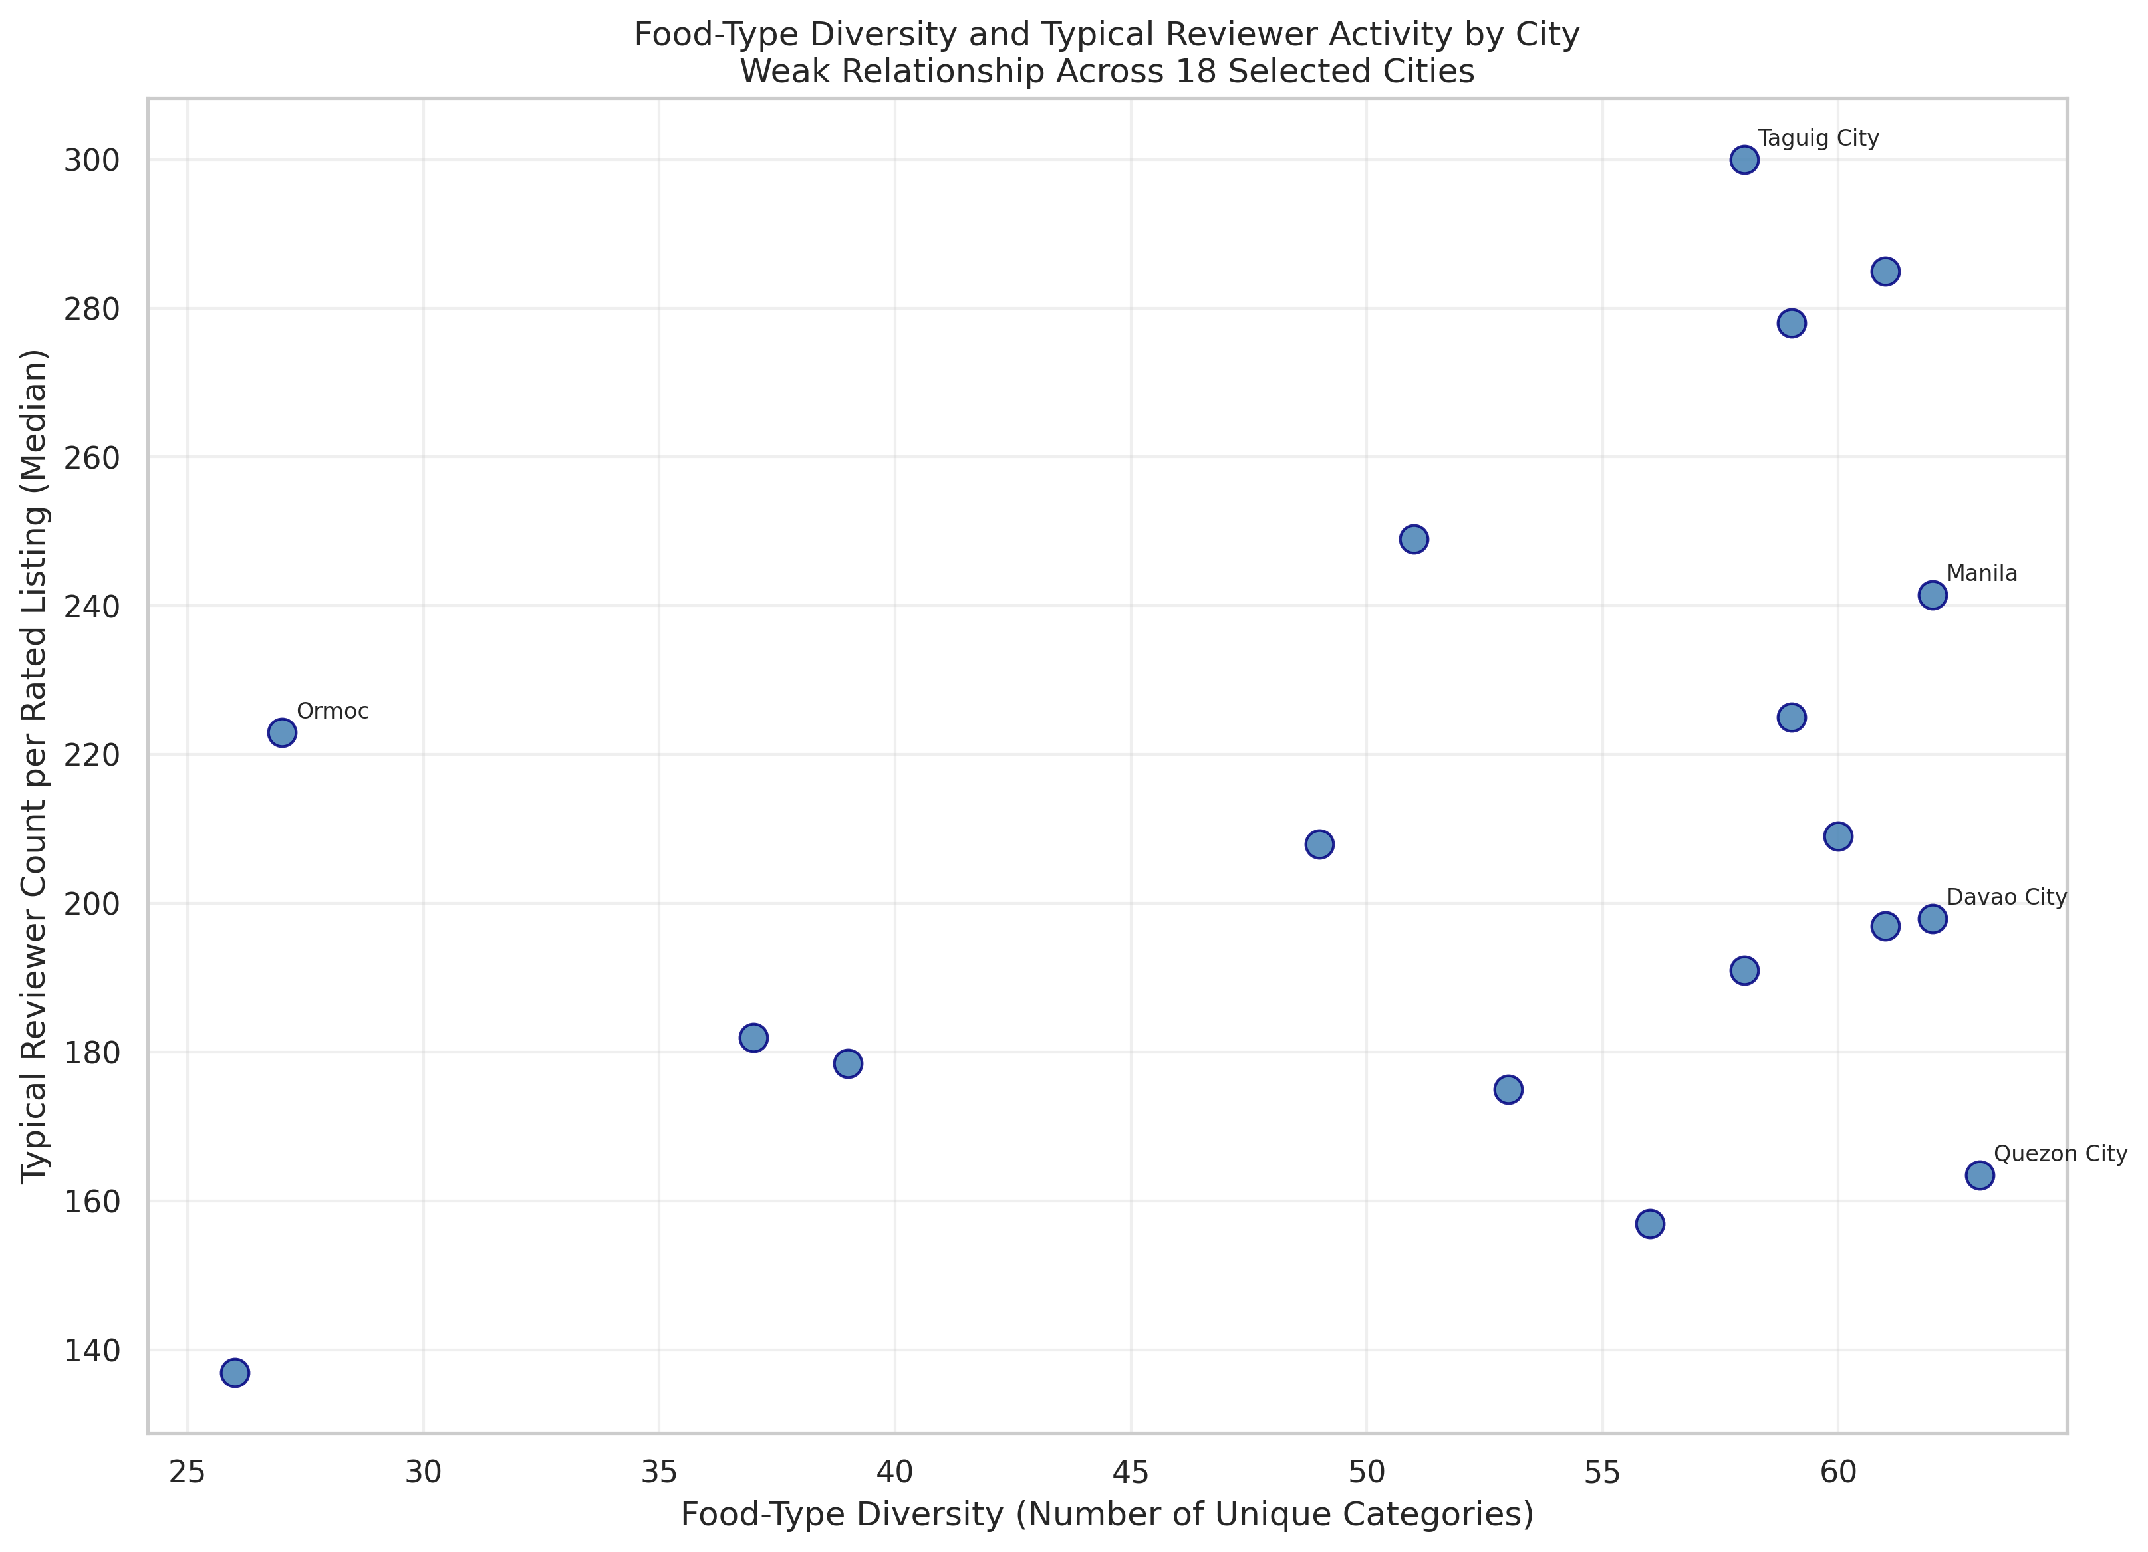
The strongest pattern mainly reflects coverage
0.938
Listings ↔ diversity
Strong; likely coverage effect
0.274
Diversity ↔ reviewers
Weak; p = 0.271
0.289
Reviewers ↔ rating
Weak but detectable
Correlation shows association—not causation.
Presenter: Nathan
Milestone 2 | Group 3
9
Notes:
PRESENTER: Nathan
SCRIPT
We used Spearman correlation because reviewer counts are uneven and contain valid extreme values. Listing count and diversity have a strong positive relationship of 0.938, but this likely reflects coverage: more listings create more chances to capture food types. Diversity and typical reviewer activity have a weak relationship of 0.274, with a p-value of 0.271, so the city-level evidence is not statistically significant. Reviewer count and rating have a weak positive relationship of 0.289. These are associations, not proof that one measure causes another. Chaim will now discuss the food-type mix and our final conclusions.
[Sources]
- Data Analysis - Milestone 2 - Corrected.ipynb
- 05_diversity_vs_reviewers.png
- Spearman results computed from Foodpanda 2025 Cleaned Data.csv

Slide 10
Food-type shares reveal different city-level mixes
How to read it
Darker blue means a larger share within that city.
Filipino food leads in 16 of 18 cities.
Chicken leads in Ormoc.
Milk Tea leads in Valencia.
Presenter: Chaim
Milestone 2 | Group 3
10
Notes:
PRESENTER: Chaim
SCRIPT
This heatmap compares the percentage share of the ten leading food types within each city. A darker blue cell means that the food type makes up a larger share of that city’s known-food listings. Filipino food has the largest share in 16 of the 18 cities. Chicken leads in Ormoc, while Milk Tea leads in Valencia. The visible cells do not total 100 percent because only the top ten food types are shown, although each percentage uses all known-food listings in the city as the denominator.
[Sources]
- Foodpanda 2025 Cleaned Data.csv
- 06_food_type_heatmap.png

Slide 11
Our findings are useful when the limitations stay visible
What the data suggests
What the data cannot prove
• Listing presence and food-type variety differ substantially across cities.
• Filipino food is the most represented category overall.
• Reviewer activity varies, while average ratings remain close to five.
• Greater diversity does not clearly correspond to much higher typical reviewer activity.
• It does not represent every operating restaurant.
• Unequal listing coverage affects city comparisons.
• Missing food types and repeated IDs may reflect collection limitations.
• Correlations do not prove causation.
• The original source, collection method, and exact 2025 coverage still require confirmation.
Presenter: Chaim
Milestone 2 | Group 3
11
Notes:
PRESENTER: Chaim
SCRIPT
Taken together, the data shows clear differences in listing presence, food-type variety, and reviewer activity. Filipino food is the most represented category, and ratings remain close to five across cities. However, the dataset does not represent every operating restaurant, and city coverage is unequal. Missing categories and repeated IDs may also reflect collection limitations. Most importantly, the relationships are exploratory and do not prove causation. Our group should also confirm the original source, collection method, and exact 2025 coverage before final submission.
[Sources]
- Data Cleanup - Milestone 2.ipynb
- Data Analysis - Milestone 2 - Corrected.ipynb
- Foodpanda 2025 Cleaned Data.csv

Slide 12
CONCLUSION
The landscape is diverse—but the evidence must be read within its coverage.
01
Listings and food-type variety differ across cities.
02
Reviewer activity varies more than average ratings.
03
Careful wording turns the data into responsible findings.
Thank you · Questions?
Erika · Arvin · Nathan · Chaim
Notes:
PRESENTER: Chaim
SCRIPT
To conclude, the selected cities show different levels of listing presence, food-type variety, and reviewer activity. The strongest pattern between listing count and diversity is likely influenced by how much data was captured in each city. Our most responsible conclusion is that the Foodpanda dataset reveals a varied restaurant-listing landscape, while its coverage limits how broadly we can generalize. Thank you for listening. We are now ready for your questions.
[Sources]
- Group 3 synthesis based on the verified Milestone 2 analysis

